Slide 1
A Bare Metal Marketplace
Ayush Upneja | Manan Monga | Haoxuan Jia | Parker Van Roy
Advisors: Sahil Tikale | Jonathan Chamberlain

Slide 2
Background Definitions
Bare Metal Node
A bare metal node is simply a physical machine with no operating system or hypervisor.
Bare Metal Marketplace
A marketplace that allows data centers to rent out bare metal nodes and remote renters to use these nodes for any purpose they like.
BOLTED Method
“Bolt” together nodes in a cluster using a series of security microservices to ensure that there are no side-channel attacks or data leaks.
Notes:
Bolt on is not a microservice, it’s a series of microservices
Microservice is anythiing with a UI/API/Interface

Slide 3
Project Description
Data center tenants with bare metal machines can rent them out
Provides bare metal nodes to users who need more resources when they want them
Connect an auction system to existing FLOCX platform
Match up bids and offers in a double-blind auction
Notes:
Bare Metal Marketplace is a platform that lets organizations rent out their bare metal machines located in data centers to make money. Also, it allows organizations or individual users who need computation power to get what they want for a satisfying price.
What we are doing in this project is adding an auction service to the existing FLOCX platform. Previous work of generating bids and offers have already been done and what we are trying to do is to match them up effectively. The way it works is quite similar to a double-blind auction, By double blind, we mean that offers are not visible to buyers and bids are not visible to sellers, users will put up a price they are willing to sell or pay for the node, and our auction system will serve as the connection and match them up to form contracts.

Slide 4
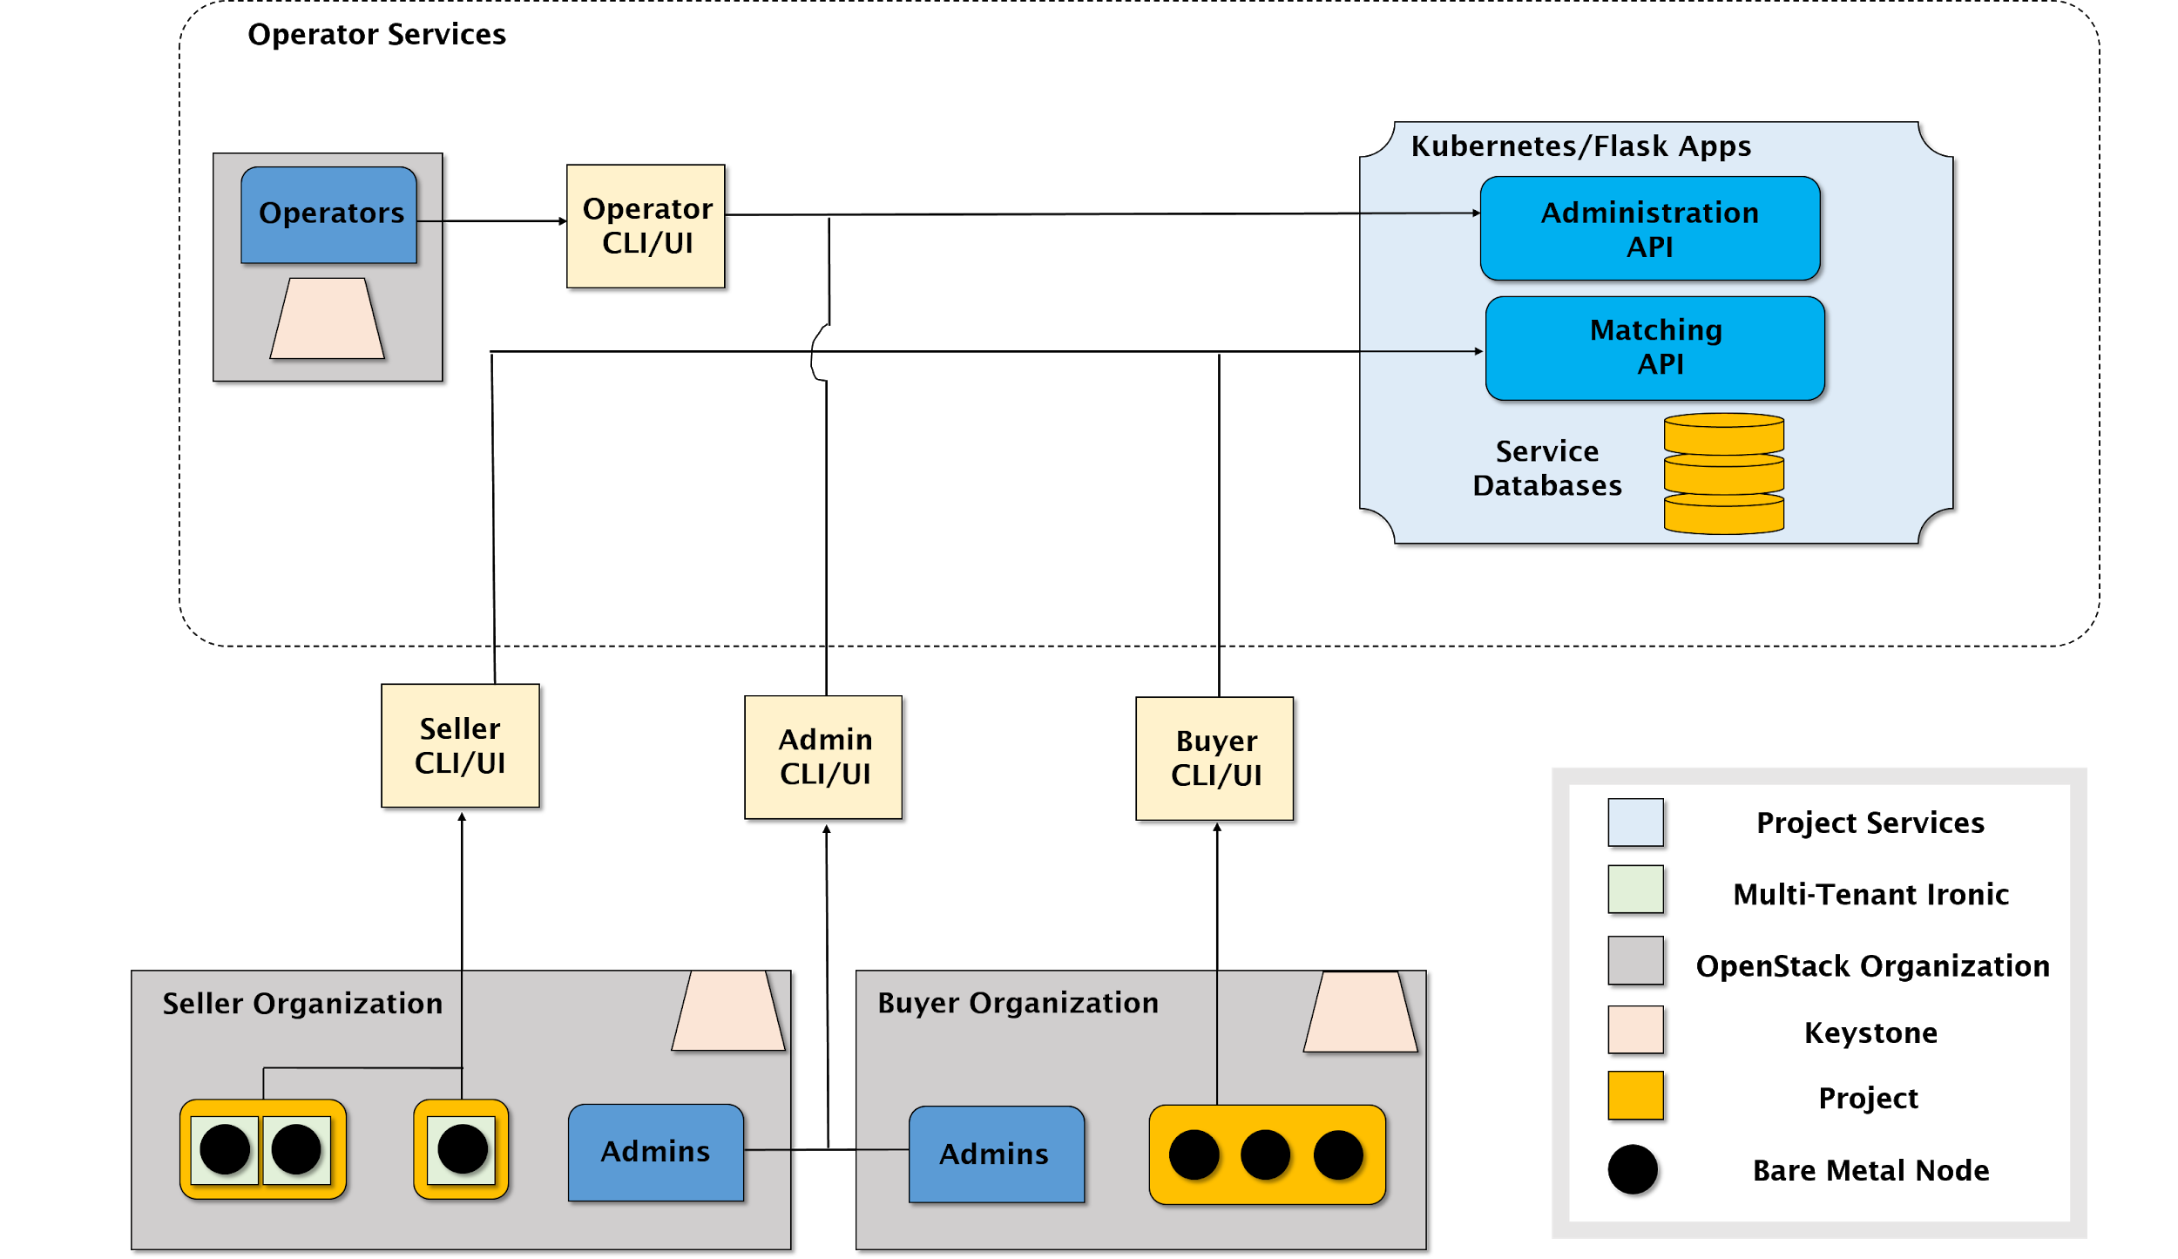
Global Architectural Structure
Notes:
Need to be explicit about which are microservices and how different users can create difference interface

Slide 5
Technologies
MySQL
CLI/React
Tox/Pytest
Flask

Slide 6

Target Users
Administrator
Administrators of clusters that care about economic efficiency
Agent
Agents who develop services to work in tandem with the marketplace or credit system
End User
End users who want to rent resources
Administrator
Administrators of clusters that care about data security
Operator
Operators that deploy and manage the auction service
End User
End users who want to rent out resources

Slide 7
MVP
Implement an auction system effectively matching bids and offers to trade bare metal machines.

Slide 8
MVP + Stretch Goals
Goals
Provide API and CLI for accessing our system
Ability to handle large scales of bids and offers
Stretch Goals
Autobuy systems for HPC and temporary scaling purposes
Enhanced UI with analytics and user dashboards

Slide 9
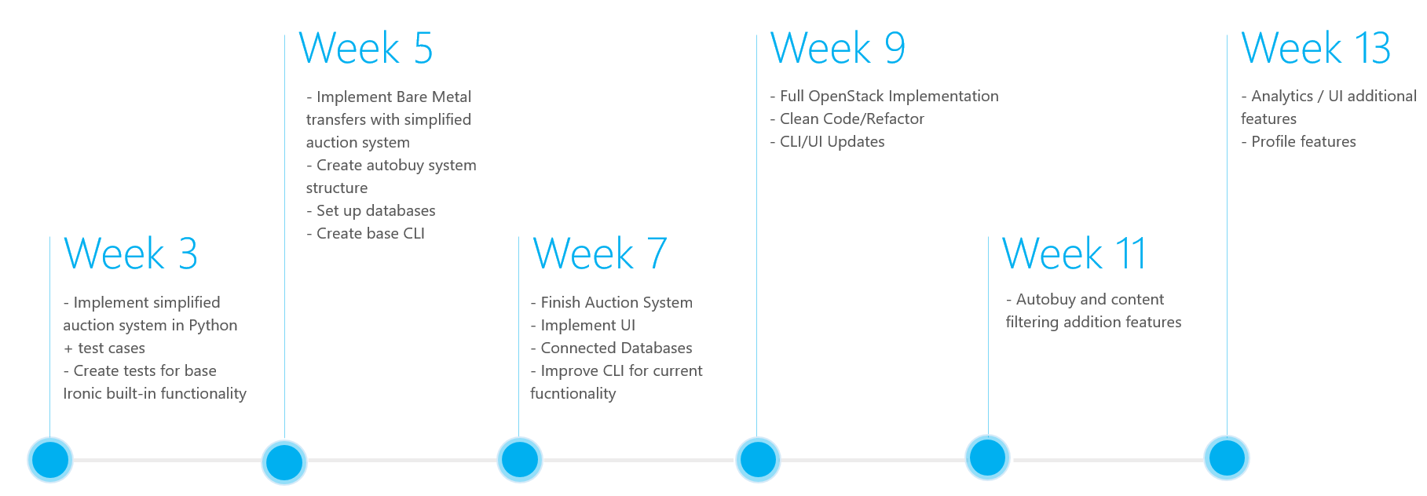
Release Roadmap

Slide 10
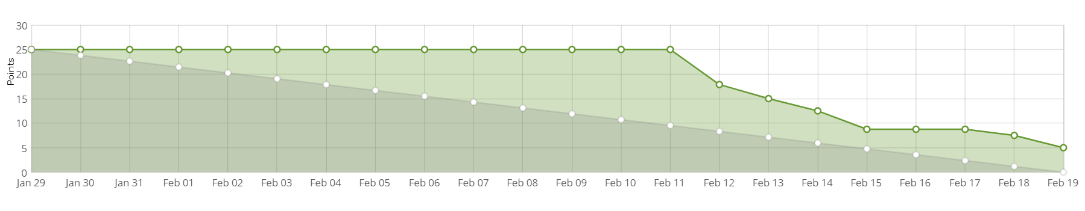
Sprint 1 Burndown Chart

Slide 11
Demo!

